Slide 1
GROUP 6-TY 07 AIA4
Darsh thakur mitu21btcs0177
Divyansh shukla MITU21BTCS0198

Slide 2
HEART DISEASE PREDICTION
RADIOLOGY TEST ANALYSIS
Developing AI for heart disease prediction involves creating a sophisticated and accurate artificial intelligence system that can analyze medical data and patient information to predict the likelihood of an individual developing heart disease.
This AI aims to assist healthcare professionals in early detection and risk assessment, thereby improving patient outcomes and reducing the burden of heart-related illnesses.

Slide 3
TECHNOLOGIES:
Programming Languages: PYTHON
Machine Learning Libraries: SCIKIT-LEARN
Data Preprocessing and Feature Engineering: PANDAS, NUMPY
Model Serialization: PICKLE
Web Interface: HTML, CSS, JAVASCRIPT

Slide 4
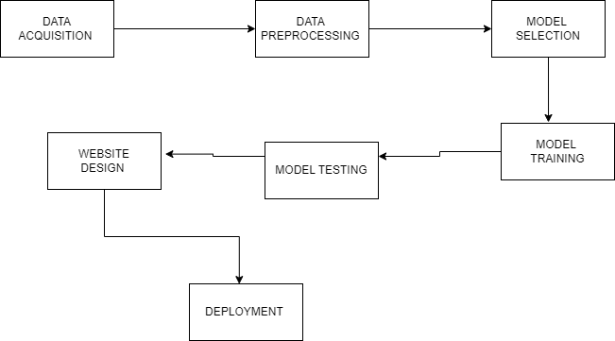
FLOW CHART:

Slide 5
DATA ACQUISITION:
Heart disease prediction dataset involves gathering comprehensive information from various sources, such as electronic health records (EHR), medical institutions, or research studies, with a focus on collecting patient-specific data, medical history, diagnostic tests, and lifestyle factors. This dataset is essential for training and validating machine learning models to predict the risk of heart disease accurately.
These all data are created and standardized for the better machine learning modelling.
SOURCE FOR THE DATA: KAGGLE

Slide 6
DATA PREPROCESSING:
Data preprocessing for heart disease prediction involves cleaning data by addressing missing values and outliers, selecting relevant features, encoding categorical variables, and scaling numerical data. Imbalanced data may require resampling.
The division of the data samples for training and testing is done in this process.

Slide 7
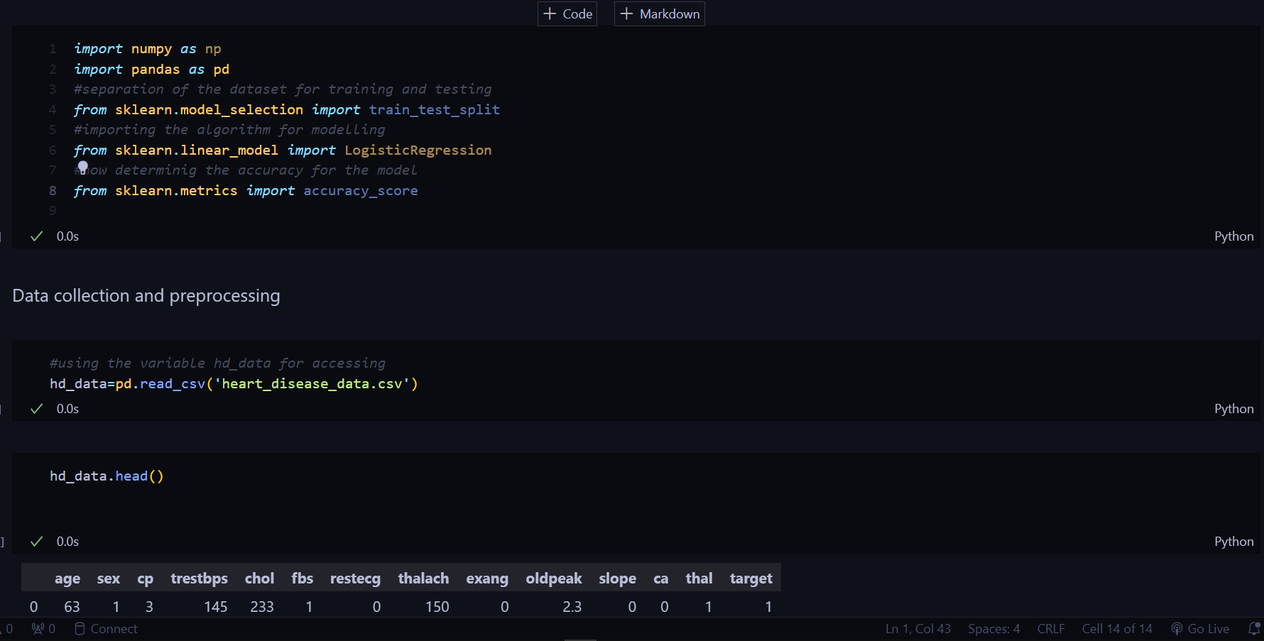

Slide 8
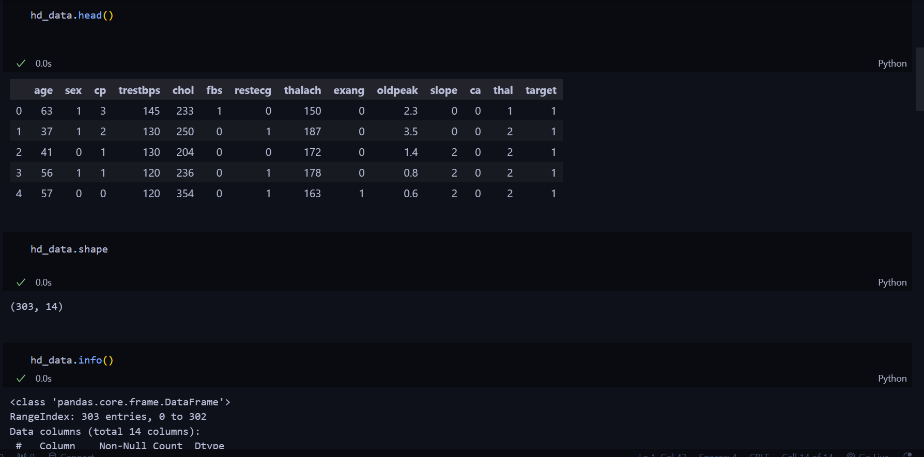

Slide 9
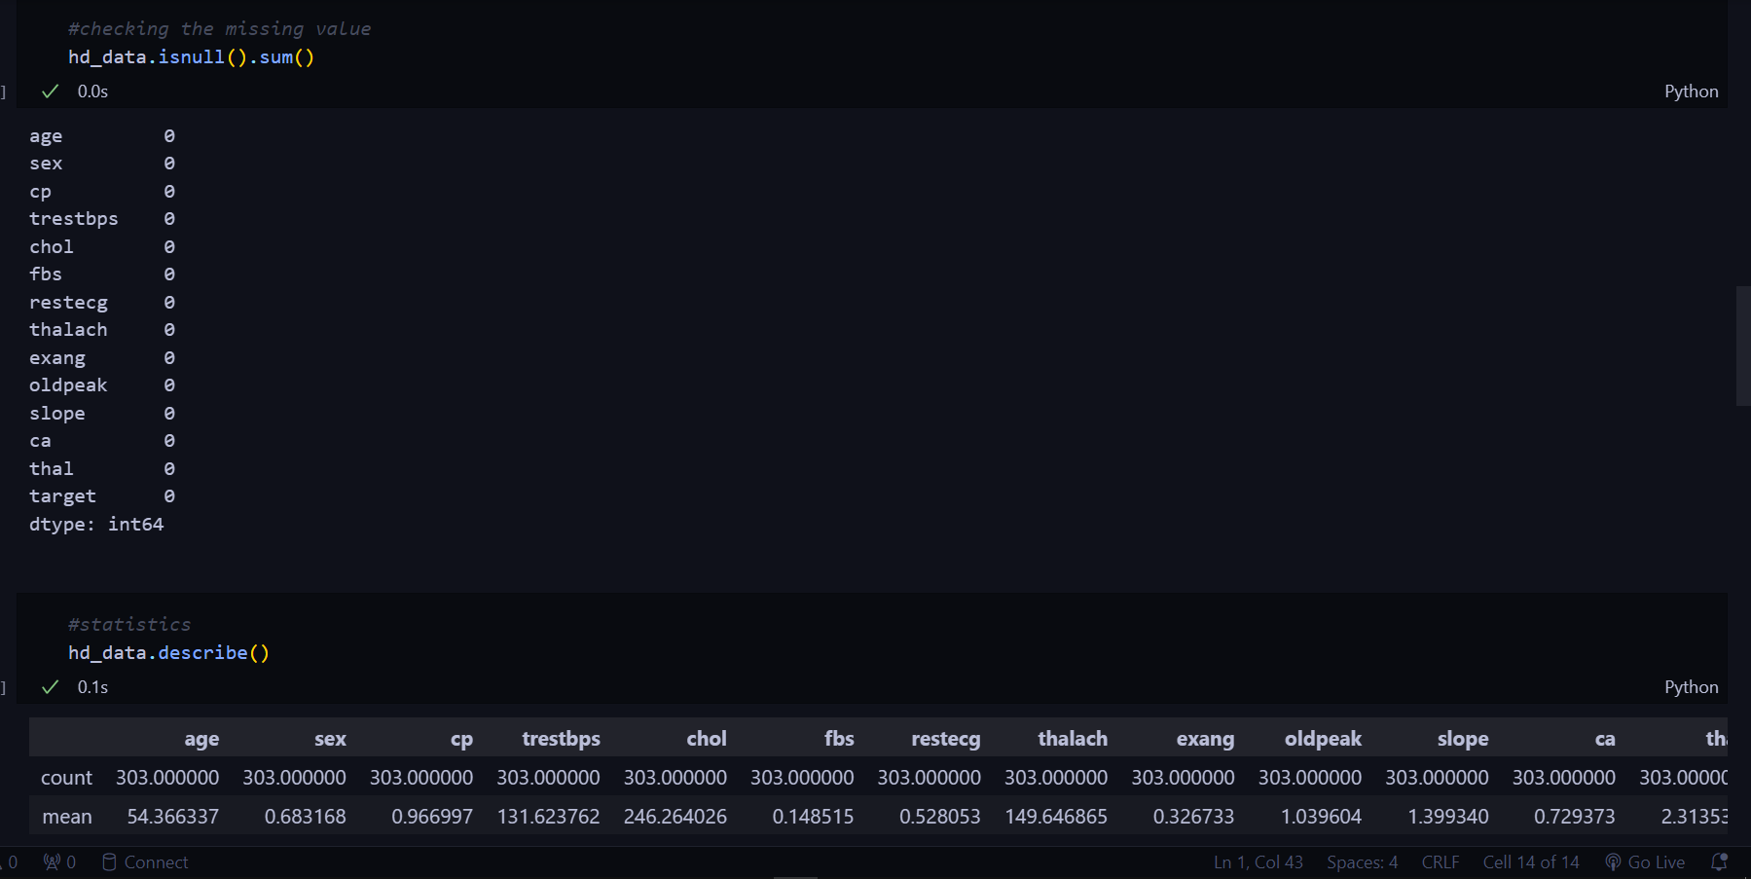

Slide 10
